Slide 1
Automata: The method and The madness
Chapter-1 (continuation) and Chapter-2 (Introductory)

Slide 2
Contents
Formal proof
Introduction to Finite Automata (Chapter-2)

Slide 3
Definitions, Theorems and Proofs
Definition: It describes the objects and notions that we use of a term
Precision is essential to any mathematical definition.
Example: A prime number is a natural number greater than one that has no position divisors other than one and the number itself.
Theorem: It is a mathematical statement on the basis of previously established statements.
Example: There is infinite numbers of prime numbers.
Proof: It is a convincing logical argument that a statement is true.
Example: Finite (N numbers of prime numbers)
P₁, P₂, P₃,…,P_{N}
Consider a prime number, x= P₁, P₂, P₃,…,P_{N}+ 1 , (x > 1)
x is also a prime number

Slide 4
Lemmas
A Lemma is a minor result whose sole purpose is to help in proving a theorem.
Example:
Theorem 1:
Theorem 2:
X=a+a=180
-> 2a=180
So, a=90
x=180
90
90
90

Slide 5
Corollaries
A corollary is a result in which the proof relies heavily on a given theorem.
Example:
Theorem 1:
Theorem 2:
Prove that, a=y and b=x
Proof:
a+b=180 -> b=180-a
a+x=180 -> x=180-a
So, b=x
Same, we can prove a=y.
x=180
b
a
y
x

Slide 6
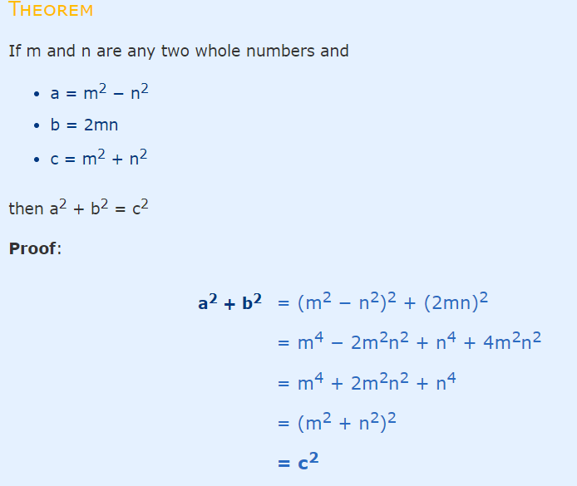
Another Example

Slide 7
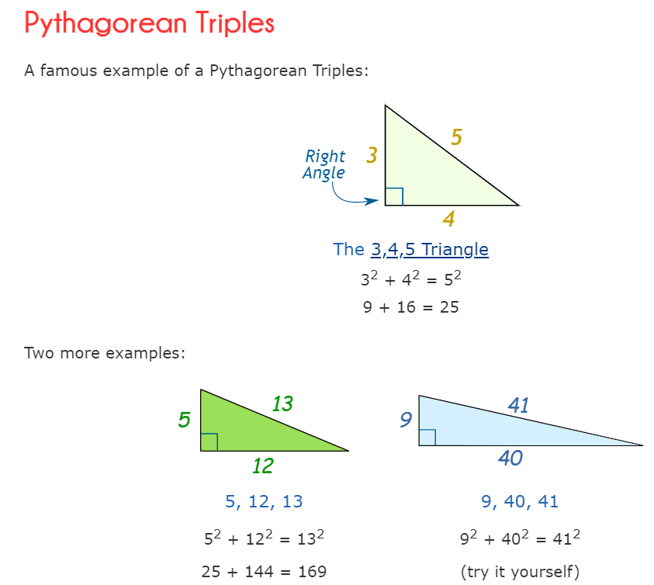
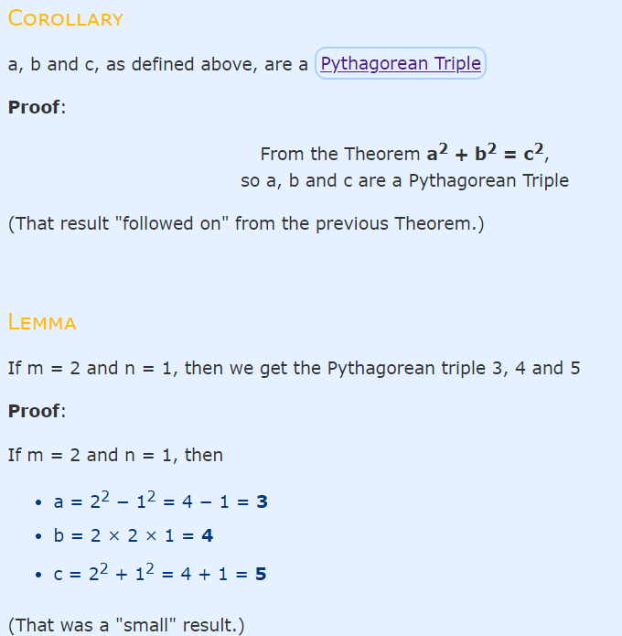
Contd…

Slide 8
Deductive Proofs
From the given statement(s) to a conclusion statement (what we want to prove)
Logical progression by direct implications
Example for parsing a statement:
“If y≥4, then 2^{y}≥y².”
(there are other ways of writing this).
given
conclusion

Slide 9
Example: Deductive proof
Let Claim 1: If y≥4, then 2^{y}≥y².
Let x be any number which is obtained by adding the squares of 4 positive integers.
Claim 2:
Given x and assuming that Claim 1 is true, prove that 2^{x}≥x²
Proof:
Given: x = a² + b² + c² + d²
Given: a≥1, b≥1, c≥1, d≥1
➔ a²≥1, b²≥1, c²≥1, d²≥1 (by 2)
➔ x ≥ 4 (by 1 & 3)
➔ 2^{x} ≥ x² (by 4 and Claim 1)
“implies” or “follows”

Slide 10
Quantifiers
“For all” or “For every”
Universal proofs
Notation=
“There exists”
Used in existential proofs
Notation=
Implication is denoted by =>
E.g., “IF A THEN B” can also be written as “A=>B”

Slide 11
Proving techniques
By contradiction
Start with the statement contradictory to the given statement
E.g., To prove (A => B), we start with:
(A and ~B)
… and then show that could never happen What if you want to prove that “(A and B => C or D)”?
By induction
(2 steps) Basis and Inductive step
By contrapositive statement
If A then B ≡ If ~B then ~A

Slide 12
Proving techniques (cont’d…)
By counter-example
Show an example that disproves the claim
Note: There is no such thing called a “proof by example”!
So when asked to prove a claim, an example that satisfied that claim is not a proof

Slide 13
Proof by Contradiction
Assume that a given theorem is false and show that this assumption leads to an obviously false consequence, called a contradiction.
Example:
Theorem: √2 is irrational.
Proof: √2 is rational.
Let √2 =a/b, where a and b are integers.
2=a²/b² => 2b²=a²
a² is even number, therefore a is even number
a=2k, where k is an integer
So, 2b²=4k²
b²=2k²
b² is even number, therefore b is even number
Condition for a rational number:
a and b co prime.
i.e., no common factor between a and b.
Irreducible
i.e., a=25, b=30, then a/b is reducible
If a=5, b=6 then it is irreducible

Slide 14
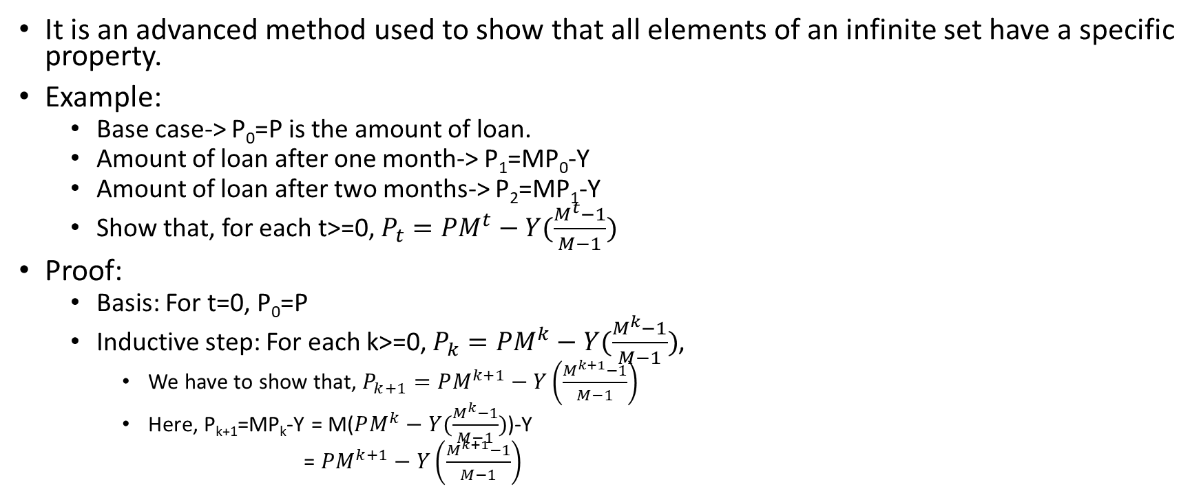
Proof by Induction
It is an advanced method used to show that all elements of an infinite set have a specific property.
Example:
Base case-> P₀=P is the amount of loan.
Amount of loan after one month-> P₁=MP₀-Y
Amount of loan after two months-> P₂=MP₁-Y
Show that, for each t>=0, $P_{t}=PM^{t}−Y(\frac{M^{t}−1}{M−1})$
Proof:
Basis: For t=0, P₀=P
Inductive step: For each k>=0, $P_{k}=PM^{k}−Y(\frac{M^{k}−1}{M−1})$,
We have to show that, $P_{k+1}=PM^{k+1}−Y\left(\frac{M^{k+1}−1}{M−1}\right)$
Here, P_{k+1}=MP_{k}-Y = M($PM^{k}−Y(\frac{M^{k}−1}{M−1})$)-Y
= $PM^{k+1}−Y\left(\frac{M^{k+1}−1}{M−1}\right)$

Slide 15
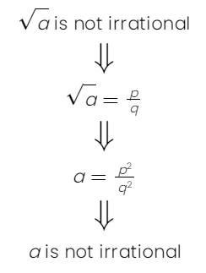
Proof by Contrapositive
It is based on the fact that p=>q means exactly the same as (not q) => (not p).
Examples:
p=“It has rained” and q=“the ground is wet”
(not q) => (not p) will be “If the ground is not wet, it hasn’t rained”
The square root of an irrational number is an irrational number.
p => q, where p=“a is irrational” and q=“√a is irrational”.
The contrapositive is (not q) => (not p) or √a is not irrational => a is not irrational

Slide 16
Proof by counter-example
A counter-example is an example that shows a statement is not always true.
It is sufficient to just give one example.
Examples:
4n+4 is always a multiple of 8 for all positive integer values.
When n=2, 4n+4=12, not a multiple of 8.
2n²-16n+31 is always positive for all values of n.
When n=4, 2n²-16n+31=-1
So not always positive for all values of n.

Slide 17
Different ways of saying the same thing
“If H then C”:
H implies C
H => C
C if H
H only if C
Whenever H holds, C follows

Slide 18
“If-and-Only-If” statements
“A if and only if B” (A <==> B)
(if part) if B then A ( <= )
(only if part) A only if B ( => ) (same as “if A then B”)
“If and only if” is abbreviated as “iff”
i.e., “A iff B”
Example:
Theorem: Let x be a real number. Then floor of x = ceiling of x if and only if x is an integer.
Proofs for iff have two parts
One for the “if part” & another for the “only if part”

Slide 19
Introduction to Chapter-2 (Finite Automata)

Slide 20
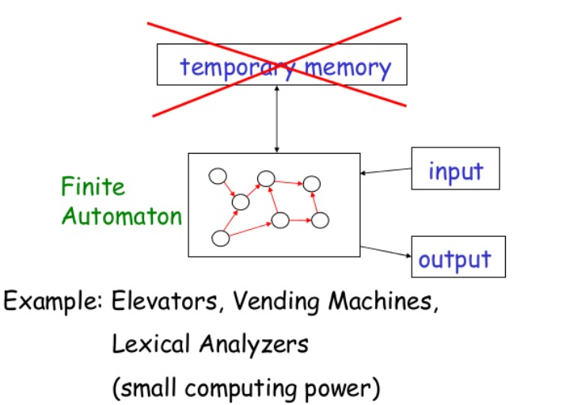
Finite Automaton

Slide 21
Examples
A
A
A
Start
0
1
Push
C
Start
C
off
on
A
A
A
A
A
C
Push
C
Example 1: An On/Off Switch
3
2
A
A
A
Example 2: Regulator of a fan

Slide 22
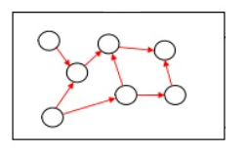
Examples
Number of 1 Odd?
{0,1,00,01,….100,…}
{Yes/No}
0
Start
S
F
1

Slide 23
Examples
Number of 1 Odd?
{0,1,00,01,….100,…}
{Yes/No}
0
1
0
0
Start
Even
Odd
1

Slide 24
Types of Finite Automata (FA)
There are two types of finite automata (FA):
Deterministic Finite Automata (DFA)
Can be one and only one state at a time
Nondeterministic Finite Automata (NFA)
Can be in several states at once
input₁
input₁
q₁
q₂
q₁
q₂
input₁
q₃
DFA
NFA

Slide 25
Deterministic Finite Automata (DFA)
A formalism for defining languages, consisting of:
A finite set of states (Q, typically).
A finite set of input symbols (Σ, typically).
A transition function (δ, typically).
A start state (q₀, one of the states in Q, typically).
A set of final states (F ⊆ Q, typically).
“Final” and “accepting” are synonyms.
So, A DFA is a five-tuple notation:
A=(Q, Σ, δ, q₀, F)
where A is the name of the DFA.

Slide 26
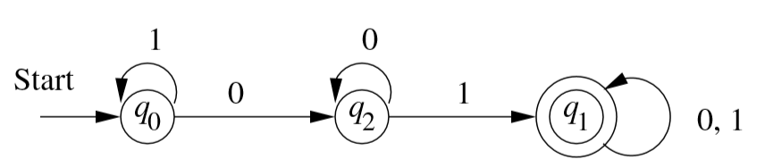
DFA (contd…)
DFA can be described as follows:
({q₀, q₁, q₂}, {0,1}, δ, q₀, {q₁})

Slide 27
Transition Function (δ)
Takes two arguments:
a state, and
an input symbol.
δ(q, a) = the state that the DFA goes to when it is in state q and input a is received.
a
q
p
δ(q, a)=p

Slide 28
Simpler Notations for DFA’s
Two preferred notations for describing automata:
Transition diagram
Graph representation of the δ function.
Transition table
Tabular representation of the δ function.

Slide 29
Transition Diagram
({q₀, q₁, q₂}, {0,1}, δ, q₀, {q₁})
A transition diagram for a DFA A=(Q, Σ, δ, q₀, F) is a graph defined as follows:
For each state in Q there is a node.
Nodes=States
For each state q in Q and each input symbol a in Σ, let δ(q, a) =p
Arcs represent transition function.
Arc from state p to state q labeled by all those input symbols that have transitions from p to q.
Arrow labeled “Start” to the start state, q₀
This arrow does not originate at any node.
Final states (those in F) indicated by double circles.
States not in F have a single circle.

Slide 30
Alternative Representation: Transition Table
A transition table is a conventional, tabular representation of a function like δ that takes two arguments and returns a value.
Final states
starred
Columns =
input symbols
0
1
*
A A B
B A C
C C C
Arrow for
start state
*
Rows = states

Slide 31
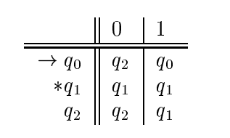
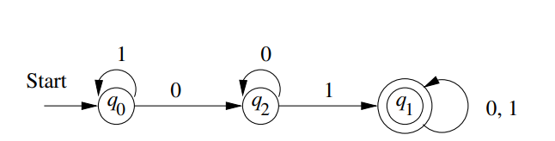
Transition Table & Transition Diagram (cont’d)

Slide 32
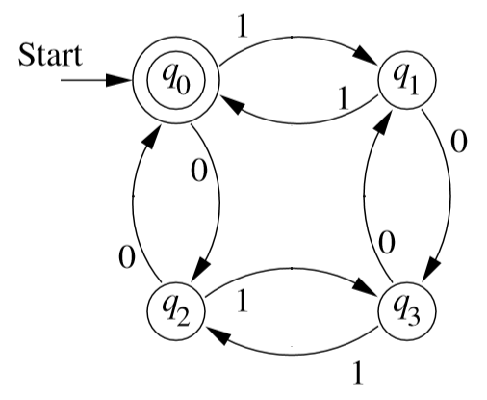
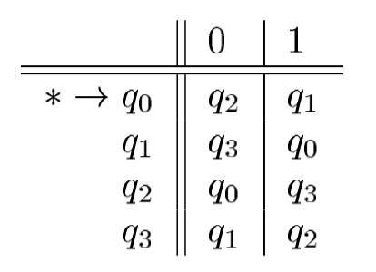
Transition diagram -> Transition table (vice versa)
Diagram to Table
Table to Diagram
Transition Diagram
Transition Table

Slide 33
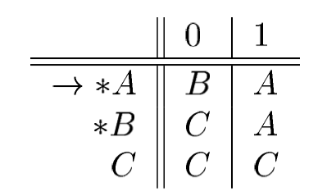
Try Yourself (Take 3 minutes for each)
1. Show a transition table for the following diagram/automata:
2. Draw a transition diagram from the following table:

Slide 34
? Questions

